Slide 1

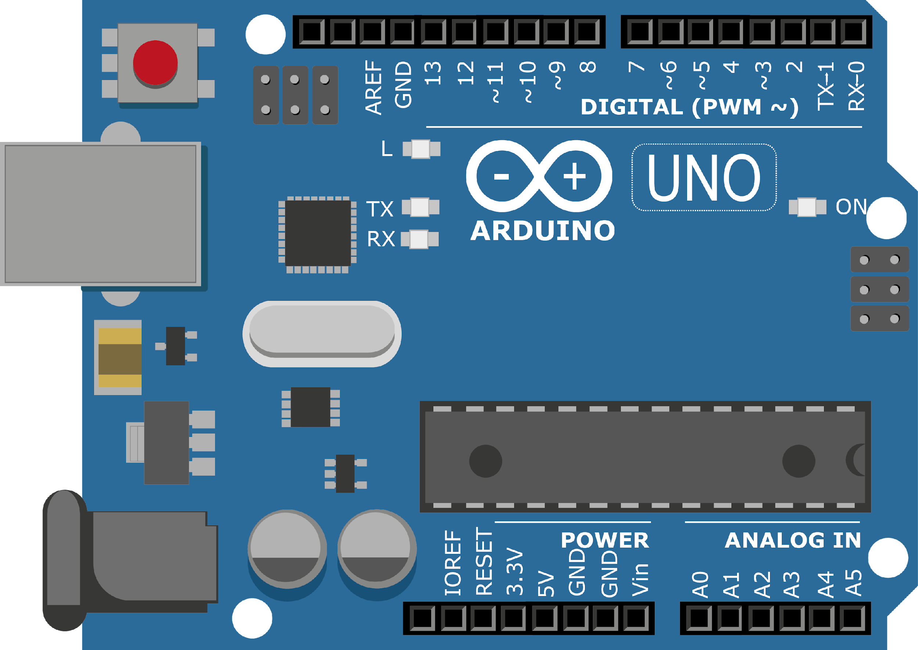
ARDUINO MASTER CLASS
02
Installing Software & Libraries | Programming Arduino

Slide 2
2 AGENDA
02
04
03
01
Arduino Programming
Arduino IDE
Installing Arduino IDE & Exploring
Installing Arduino Libraries

Slide 3

ARDUINO IDE
The Arduino Integrated Development Environment is a cross-platform application that is written in functions from C and C++.
It is used to write and upload programs to Arduino compatible boards, but also, with the help of third-party cores, other vendor development boards.

Slide 4
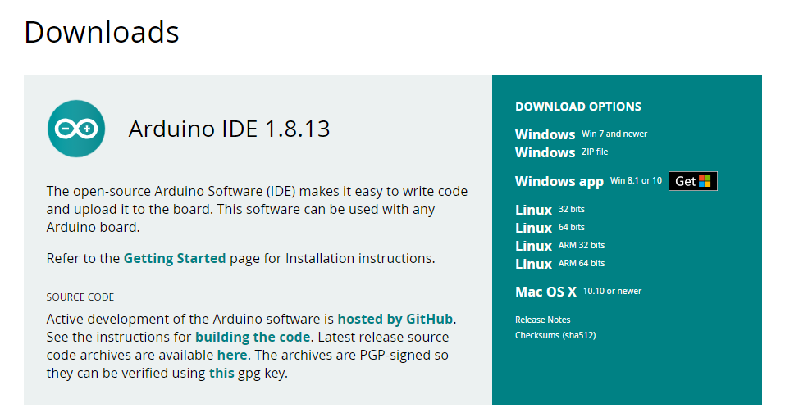
INSTALLING ARDUINO
https://www.arduino.cc/en/software

Slide 5
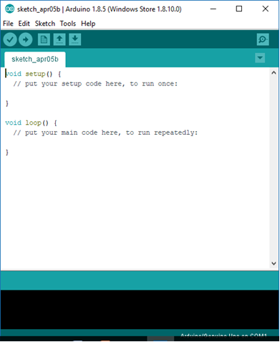
PROGRAMMING ARDUINO – EXPLORING IDE
Open Arduino IDE
Select File > New
New blank file will open as shown in Fig.
Code should be written on this program space.
After writing the code, it should be compiled and burn to the Arduino board via COM port through USB serial.

Slide 6
BASIC PROGRAMMING SYNTAX- ARDUINO
If - Else
For
if (someCondition)
{
// do stuff if the condition is true
}
else
{
// do stuff if the condition is false
}
for (initialization; condition; increment)
{
// statement(s);
}

Slide 7
BASIC PROGRAMMING SYNTAX- ARDUINO
while
Switch
while (condition) {
// statement(s)
}
switch (var) {
case label1:
// statements
break;
case label2:
// statements
break;
default:
// statements
break;
}

Slide 8
HARDWARE CONFIG SYNTAX - ARDUINO
pinMode digitalRead digitalWrite analogRead analogWrite delay serialRead serialWrite

Slide 9
INBUILT LED BLINK - ARDUINO
void setup() { pinMode(13, OUTPUT); } void loop() { digitalWrite(13, HIGH); delay(1000); digitalWrite(13, LOW); delay(1000); }

Slide 10

INTERVIEW QUESTIONS
What are the software structure functions?
What is mean by IDE?
In which language Arduino software was written?

Slide 11

THANKS!

Slide 12

Q & A SESSION

